Slide 1
REQUEST FOR PROPOSALS:
RFP-MCMHTF-2026
Morgan County – Mooresville Opioid Settlement Grants
Virtual info session
January 15, 2026

Slide 2
MCMHTF Background
As part of the Better Communities Coalition, the Morgan County Mental Health Task Force (MCMHTF) was established in 2021.
Comprised of more than 100 individual members representing over 50 organizations, the MCMHTF envisions a community where all individuals are supported in achieving mental health wellbeing.
The task force utilizes the Strategic Prevention Framework to collaboratively assess and address community mental health needs.
The MCMHTF is dedicated to upholding core values throughout the grantmaking process. We emphasize collaboration, inclusivity, transparency, and trust, while making data-informed decisions focused on achieving measurable results.

Slide 3


MCMHTF Oversight
On May 6, 2024, the Morgan County Board of Commissioners (Commissioners) approved the MCMHTF’s request to develop and oversee a process of seeking proposals for the distribution of the National Opioid Settlement Funds.
On November 18, 2025, the Mooresville Town Council (Town Council) voted to collaborate with Morgan County in this effort, contributing $15,000 toward the nearly $190,000 available in grant funding for 2026.
As part of this process, the MCMHTF will make recommendations to the Commissioners of the most meritorious applications for funding. The dates for awarded projects are at the discretion of the Commissioners with a target date of awards made by May 2026, or until all funds are committed.

Slide 4
Disclaimer
This request for proposals (RFP) is intended to publicize the availability of grant opportunities for services described herein. Neither the issuance of this RFP nor the receipt of any responses thereto shall create any obligation by the MCMHTF, Commissioners, or Town Council to make any award pursuant hereto. The award of any grant(s) as a result of this RFP shall be at the sole discretion of the Commissioners with recommendations from the MCMHTF. Neither this RFP nor any proposed project submitted hereto are to be construed as a legal offer.

Slide 5
Workgroup Guiding Principles
The process should be accountable and transparent.
The MCMHTF welcomes input from a broad cross section of community members to include those with lived experiences and those in long-term recovery.
All local opioid settlement funds awarded through this grantmaking process shall:
  Be for approved abatement uses as outlined in Exhibit E, and/or
  Be for uses that support combatting substance use disorder across the continuum from prevention through long-term recovery.
Local opioid settlement funds should be awarded to effective, scientifically supported initiatives with articulable performance measures.
Initiatives that increase access to behavioral health services should be prioritized.
Initiatives should target the areas of greatest need with potential for greatest impact.
Funds should not be used to supplant funding for existing programs but may be used to supplement or increase.

Slide 6
Eligibility Requirements
This grant aims to promote innovative, collaborative, community-driven, cross-sector responses to substance use disorder issues that will save lives and reduce harm. This RFP requests responses from any Morgan County service providers (and those providing services to Morgan County residents), including but not limited to substance use and mental health treatment providers, collaboratives and coalitions, schools, law enforcement agencies, nonprofit organizations, hospitals and healthcare entities, public health organizations, businesses, and agencies focused upon promoting long-term recovery.
Respondents should be embedded in, and working with, their communities and interested in submitting effective proposals for services that build upon efforts already made, including but not limited to the expansion of and access to treatment for substance use disorder, stronger connections to recovery supports, development and implementation of prevention practices, expansion of harm reduction efforts, and substance-related criminal justice interventions.

Slide 7
Submission/Content Requirements
Applicants must submit proposals by Wednesday, February 25, 2026, at 4 p.m. (EST) via Smarter Select.
Only one proposal per respondent per funding type (abatement or unrestricted).
Must use Times New Roman, single-spaced, 12-point font for all pages of the proposal.
Project narrative may not exceed eight pages in total length. This does not include action plan, budget, or any other supporting documentation.
Application Link Here

Slide 8
Letters of Support
Letters of support (LOS) are not required, but may be submitted, as part of the grant application.
The policy: Members of the MCMHTF Local Opioid Settlement Funds Workgroup, or employees of workgroup member organizations, may not provide LOS for grant applications.
Example: Keylee Wright is a member of the workgroup and an employee of the Kendrick Foundation. Keylee cannot write an LOS for a grant application, and no employee of the Kendrick Foundation may write an LOS for a grant application.

Slide 9
RFP Timeline (*Subject to Change)
February 25, 2026: RFP closes at 4 p.m. (EST)
February 25 - March 27, 2026: Applications evaluated and reviewed
April 7, 2026: Finalists should be available for in-person interviews (if requested) with the MCMHTF and should be prepared to address any questions or concerns regarding applications
April 20 or May 4, 2026: Recommendations for funding will be shared at the Commissioners’ meeting
May 2026: Notices of award sent via email
June or July 2026: Press release and awardees recognized at a MCMHTF meeting
July 1, 2026-June 30, 2027: Project period

Slide 10
Funding Information
This funding comes from the National Opioid Settlement with distributors McKesson, Cardinal Health, and AmerisourceBergen and manufacturer Janssen Pharmaceuticals, Inc., and its parent company Johnson & Johnson.
The total funding amount available for this RFP is approximately $190,000:
  $90,000 for approved abatement uses as outlined in Exhibit E – All proposed activities and expenses must meet the requirements set forth in Exhibit E. For a listing of items not included in allowable expenses under Exhibit E, please go to https://www.in.gov/recovery/files/State-Recommendations-for-Use-of-Settlement-Funds-11.14.2024.pdf.
  $100,000 unrestricted – Unrestricted distributions are not restricted to a specific purpose; however, per the RFP, must also be used to support combatting substance use disorder across the continuum from prevention through long-term recovery.
Awards may be greater or less than the respondent’s requested amount. Final proposals will be judged on the totality of responses. Cost efficiency will be considered when determining grant awards.

Slide 11
Scoring
Cover Letter (5 points) – 1 Page Maximum
a) Primary and secondary program contact information (name, email, and phone number).
b) Basic introduction of respondent agency (name, mission, and services).
c) Total amount of funds requested.
d) Priority population(s).
e) Approximate number of people to be served.
f) Identify whether applying for approved abatement uses as outlined in Exhibit E or unrestricted uses.
Proven Past Experience (15 points) – 2 Page Maximum
a) Provide a thorough explanation of respondent agency's experience in implementing an initiative of this kind.
b) Have these past initiatives been effective, scientifically supported, and measurable? How so?
c) Describe respondent agency's qualifications and its staff's qualifications to implement initiatives of this kind.

Slide 12
Scoring
Proposed Project Description (25 points) – 3 Page Maximum
a) Identify methods used to target services to your proposed priority population(s), and to address any current gaps in Morgan County. Clearly describe how your project reflects the inclusion of the perspective of people with lived experience of substance use disorder and/or who are in long-term recovery.
b) Describe the proposed project in detail:
If applying for approved abatement uses, clearly identify which specific strategies you're implementing from Exhibit E. List of Opioid Remediation Uses, or
If applying for unrestricted uses, please include evidence-informed and/or innovative strategies that support combatting substance use disorder across the continuum from prevention through long-term recovery.
Additionally, what services will be provided, and who will provide them? Why are these important? What are their benefits? Who are your collaborative partners? Why do you think this approach will be effective in combatting substance use disorder? Clearly identify how the project aligns with the MCMHTF Guiding Principles.
c) Provide a realistic timeline for the implementation of the project.
d) Describe how you will measure the success of this project. Include both descriptive and numeric measures of success, if possible. Briefly describe any sources of data that will be collected to measure program successes including short- and long-term outcomes (i.e. surveys, attendance records, dropout rates, etc.).
e) What barriers to success do you anticipate, and how do you plan to address them?

Slide 13
Scoring
Project Sustainability Long-Term (20 points) – 2 Page Maximum
a) How are your current services funded? Show how these funds will not be used to supplant current funding sources.
b) Once 100% of your potentially awarded funds are utilized, how will you sustain this project long-term to continue making a difference?
Action Plan (25 points) – Use the template provided HERE
Fill in all areas of the template as appropriate. There are tables for four strategies (delete and add tables based on number of proposed strategies). Strategies outlined in your action plan should mirror those in the proposed project description and include detailed action steps, needed resources, person(s) responsible, performance indicators, and timeframes for implementation.

Slide 14
Scoring
Budget (10 points) – Use the template provided HERE
Put the proposed project budget in the provided table format. The proposed budget must be detailed and include components such as: anticipated wage/salary expenses including amounts of personnel hours allocated weekly or overall to the project, and benefits and payroll tax expenses; materials and supplies expenses that are broken down into discrete categories with clear justification of need; training or professional development expenses with accurate estimates of cost per item; cost-sharing; etc. Preference will be given to proposals that cap administrative and/or indirect costs at 3%. All proposed budget items that are administrative or indirect should be thoroughly explained, defined, and have a clear justification of need. Click HERE to see items not included in allowable expenses under Exhibit E as outlined in State of Indiana Recommendations for Spending National Opioid Settlement Funds (adopted by the Indiana Commission to Combat Substance Use Disorder on November 14, 2024).

Slide 15
Scoring
Bonus Points (Up to 10 points)
Applications clearly addressing the MCMHTF priorities may potentially receive up to 10 bonus points.
a) Access to behavioral health services – Up to 5 points
b) Priority populations include low-income, unhoused, Department of Child Services-involved, and/or LGBTQIA+ – Up to 5 points

Slide 16
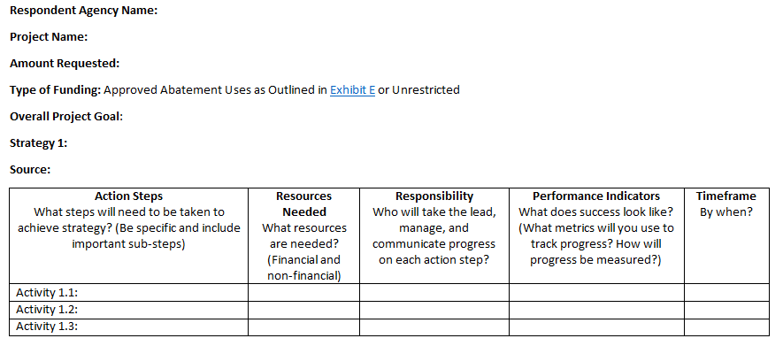
Action Plan Template
Use of the Action Plan Template is required.
Action Plan Template Here

Slide 17
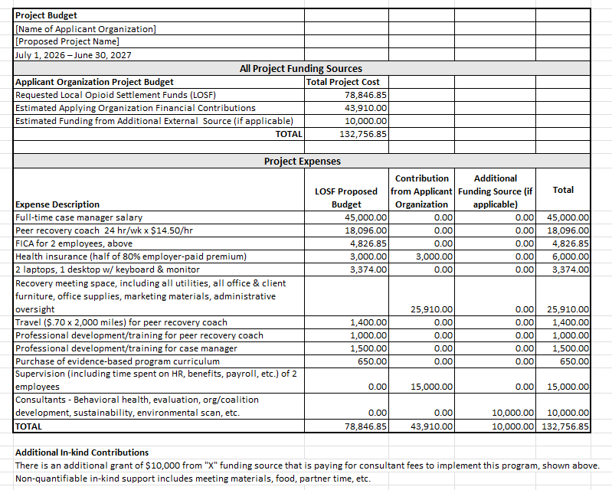
Budget Template
(Example)
Budget Template Here

Slide 18
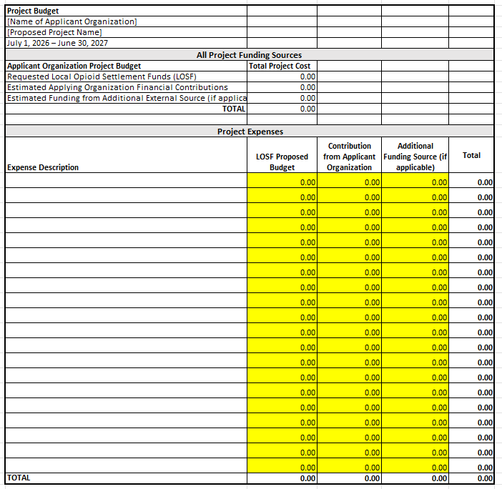
Budget Template
Use of the Budget Template is required.
Budget Template Here

Slide 19
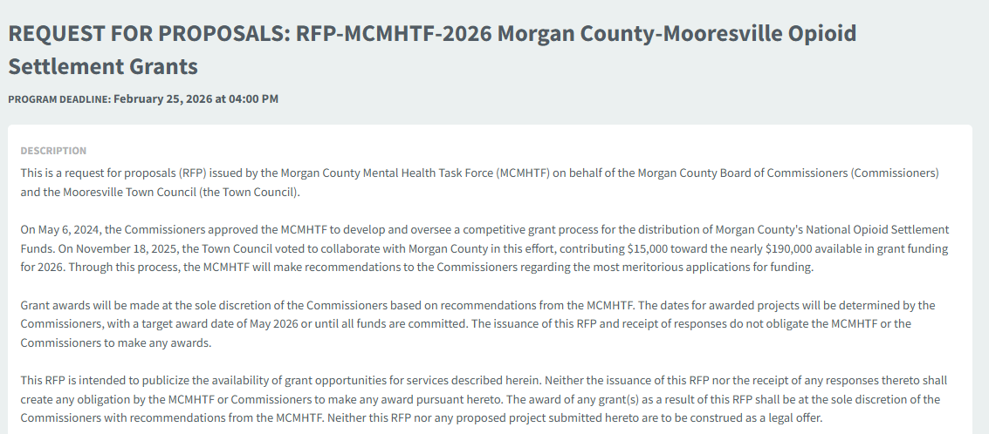
Smarter Select
If you do not already have one, you will need to create a Smarter Select account. It is free and simple.
Application Link Here

Slide 20
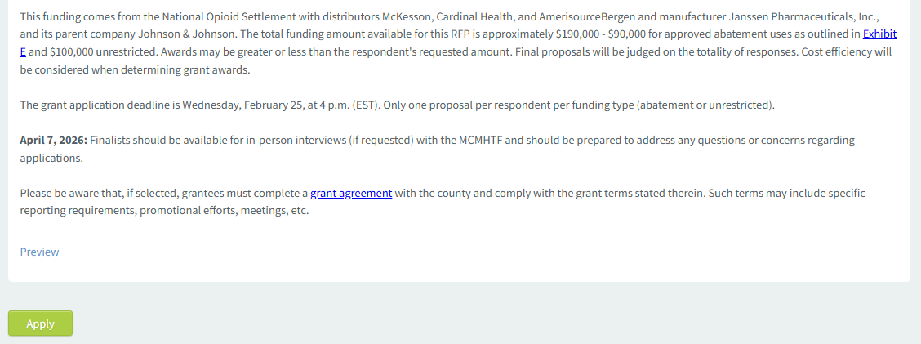
Smarter Select
It is recommended that you review the Smarter Select application form to see all the elements needed. There are pieces that will not be scored but are still required.
Smarter Select does not have a spelling/grammar check feature. Please consider copying and pasting your information into the form.
You may edit your submitted application up until the due date when the application window closes.
Application Link Here

Slide 21
Important Links
Morgan County – Mooresville Opioid Settlement Funds website
Request For Proposals RFP-MCMHTF-2026
Smarter Select Application
Frequently Asked Questions
Action Plan Template
Budget Template
Exhibit E
Indiana Commission to Combat Substance Use Disorder Opioid Settlement website
State of Indiana Recommendations for Spending National Opioid Settlement Funds

Slide 22
QUESTIONS?

Slide 23
Thank you!
Please direct all questions to mcmentalhealthtaskforce@gmail.com.

